Slide 1
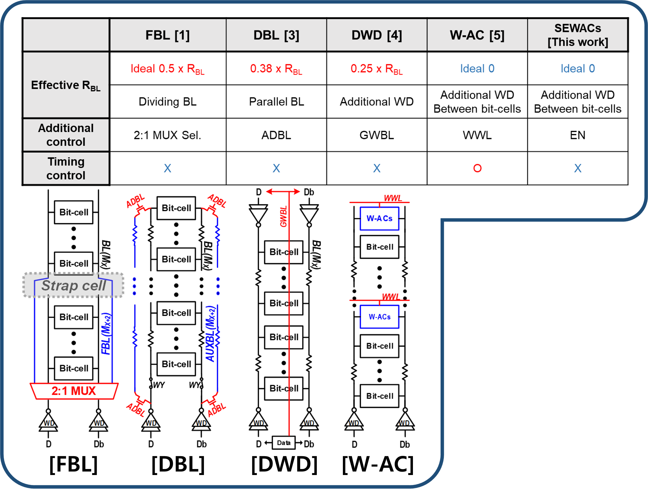
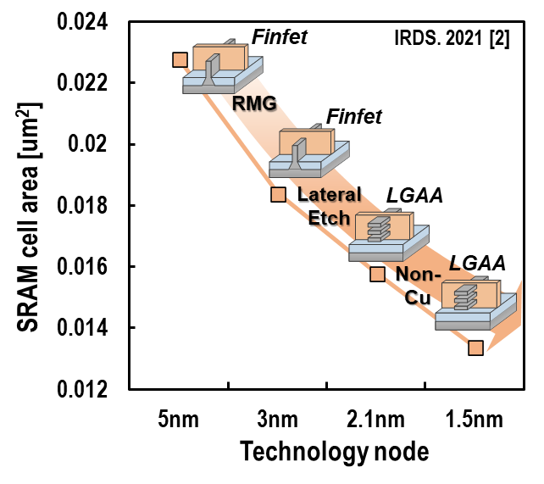
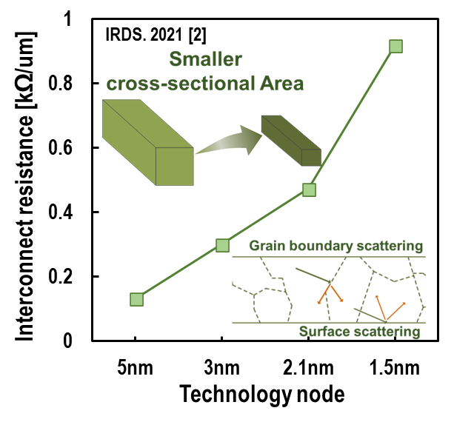
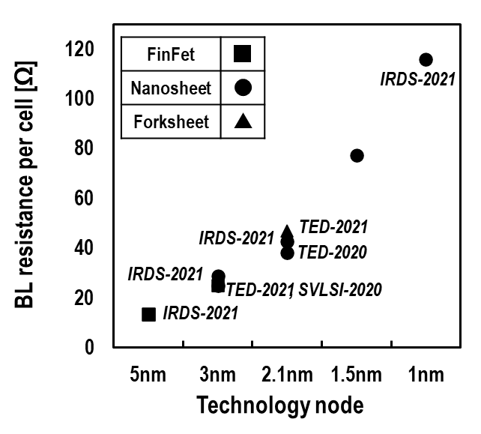
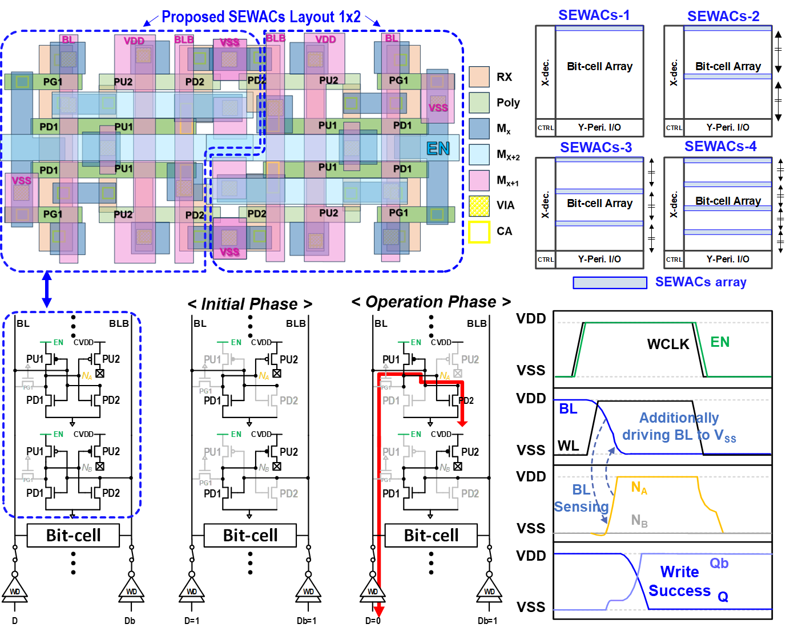
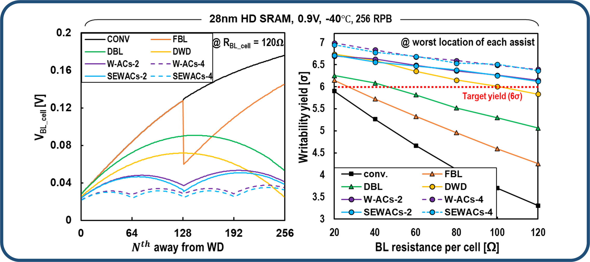
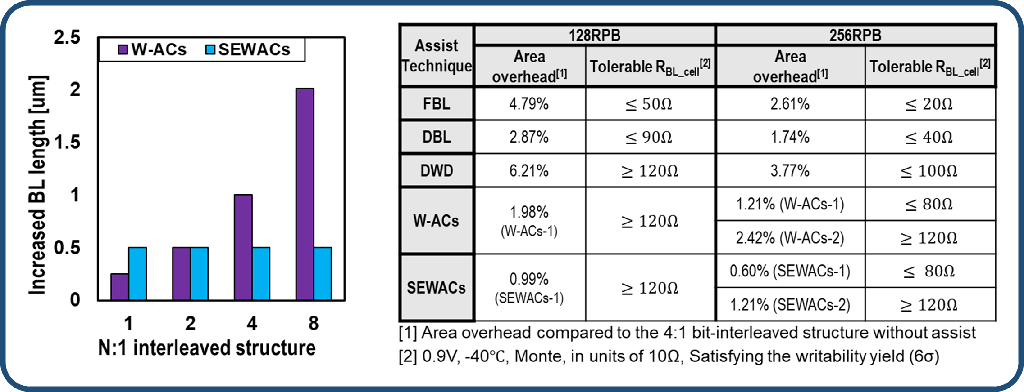
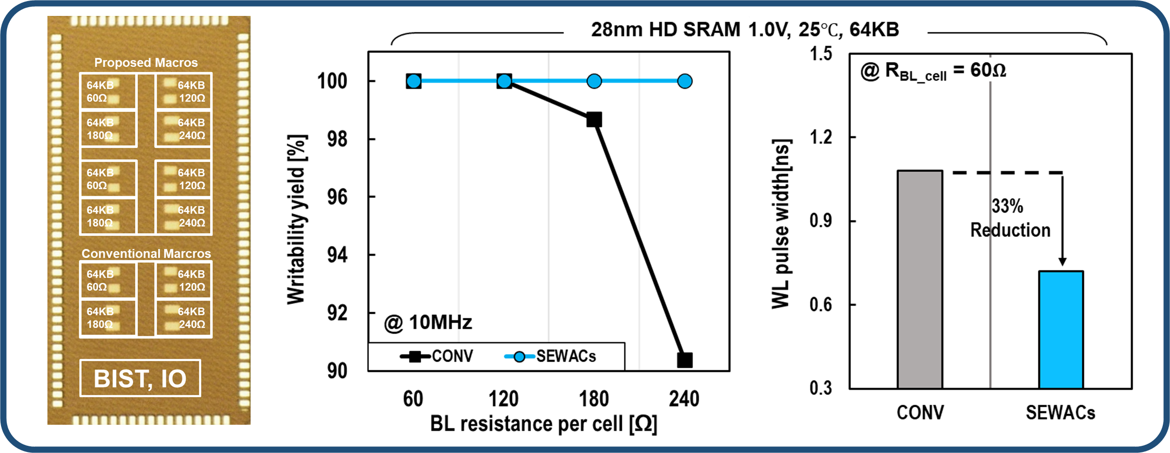
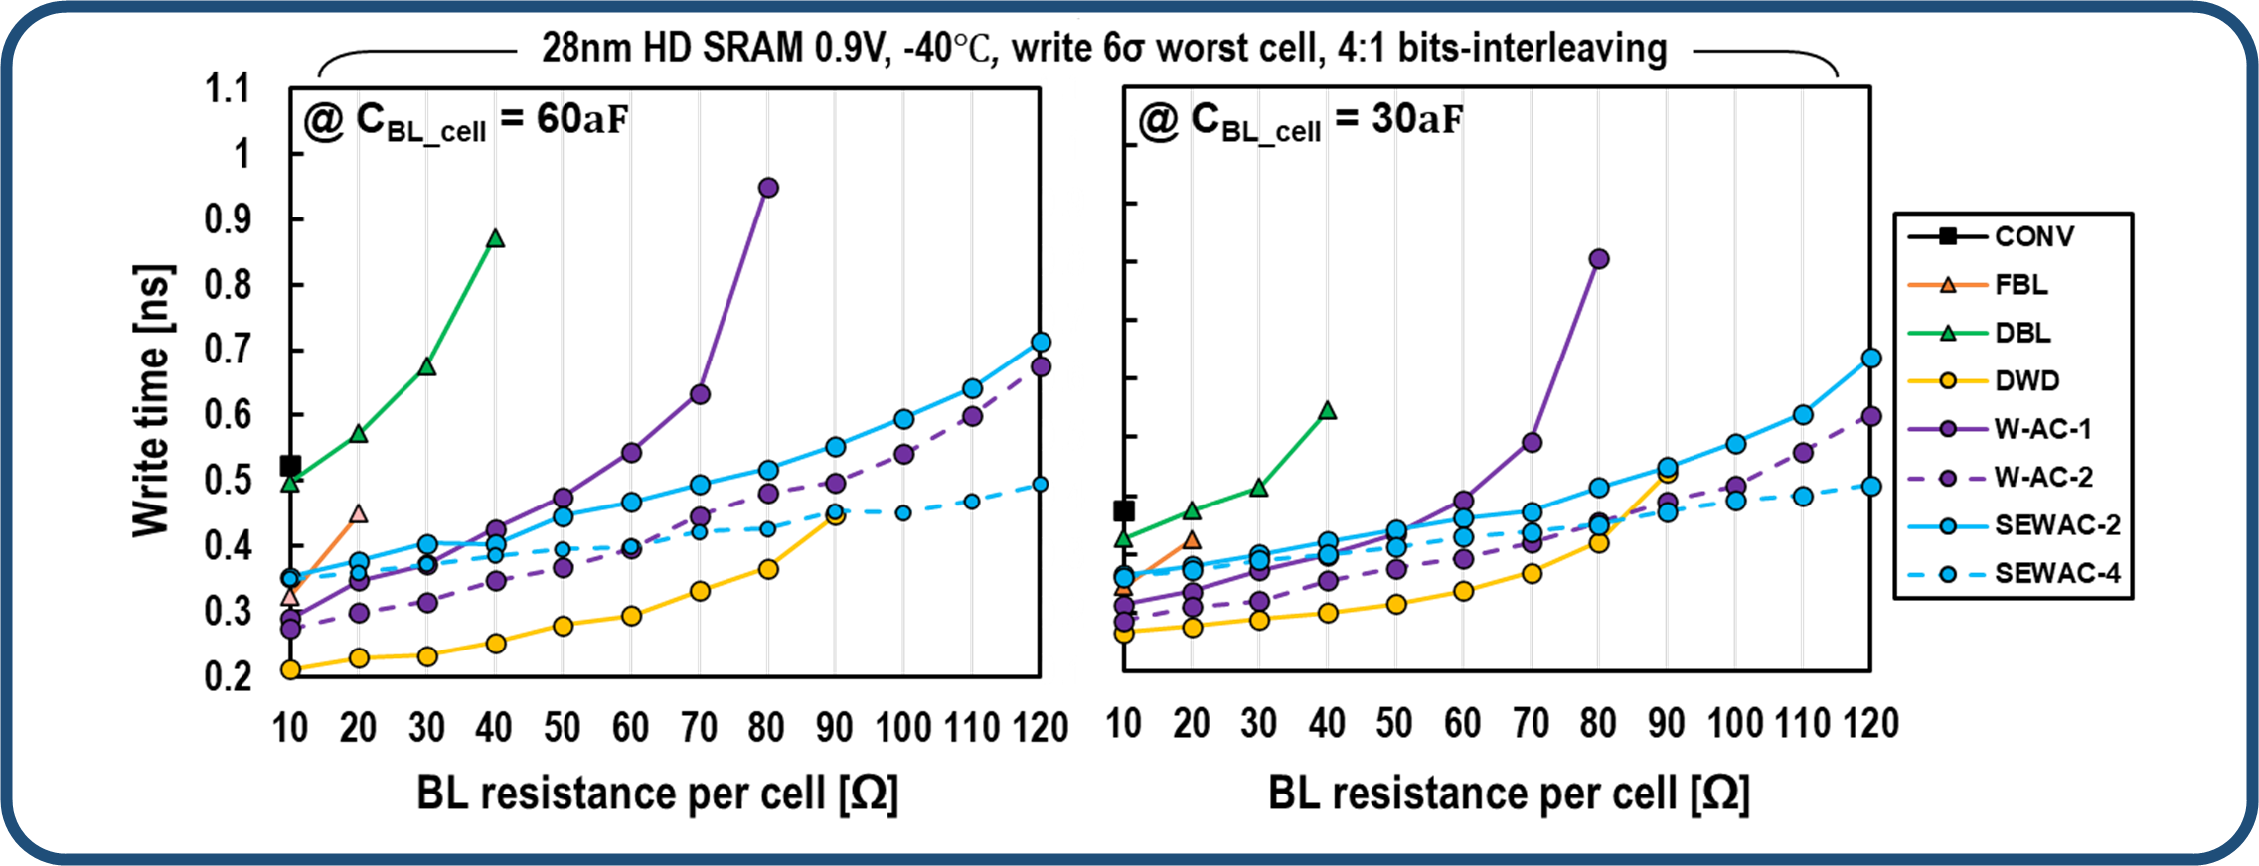
Self-Enabled Write-Assist Cells for High-Density SRAM in a Resistance-Dominated Technology Node
Minjune Yeo¹, Keonhee Cho², Seung Jae Yei¹, and Seong-Ook Jung¹
¹Yonsei University, ²Samsung Electronics, Korea
1. Introduction
2. Previous Work
The need for high-density SRAM increases in applications that process a lot of data in a limited area.
For high-density SRAM, cell area is gradually reduced through technology scaling (Figure 1-1).
However, in higher tech., resistance increases exponentially due to a decrease in the cross-sectional area and mobility of the interconnect. (Figure 1-2)
As a result, the BL resistance per SRAM cell increases, severely reducing the SRAM write yield (Figure 1-3).
Overcoming the limitations of the previous structure
Self-Enabled Write Assist cells (SEWACs)
Figure 1-1
Figure 1-2
Figure 1-3
3. Proposed Work (SEWACs)
4. Simulation Result
Best write performance improvement
Cell-compatible structure created by modifying two SRAM
Operates by sensing BL discharge by write driver
no effect on other operations
5. Chip measurement
Has the smallest area overhead in a 4:1 bit-interleaved structure
Verification of performance of proposed structure through chip measurement
Has the smallest area overhead in a 4:1 bit-interleaved structure

